Slide 1
Project 4 Golden AMI Deployment
Configure EC2 with web server
Create Golden AMI
Launch multiple EC2 instances from AMI
Verify identical configuration

Slide 2
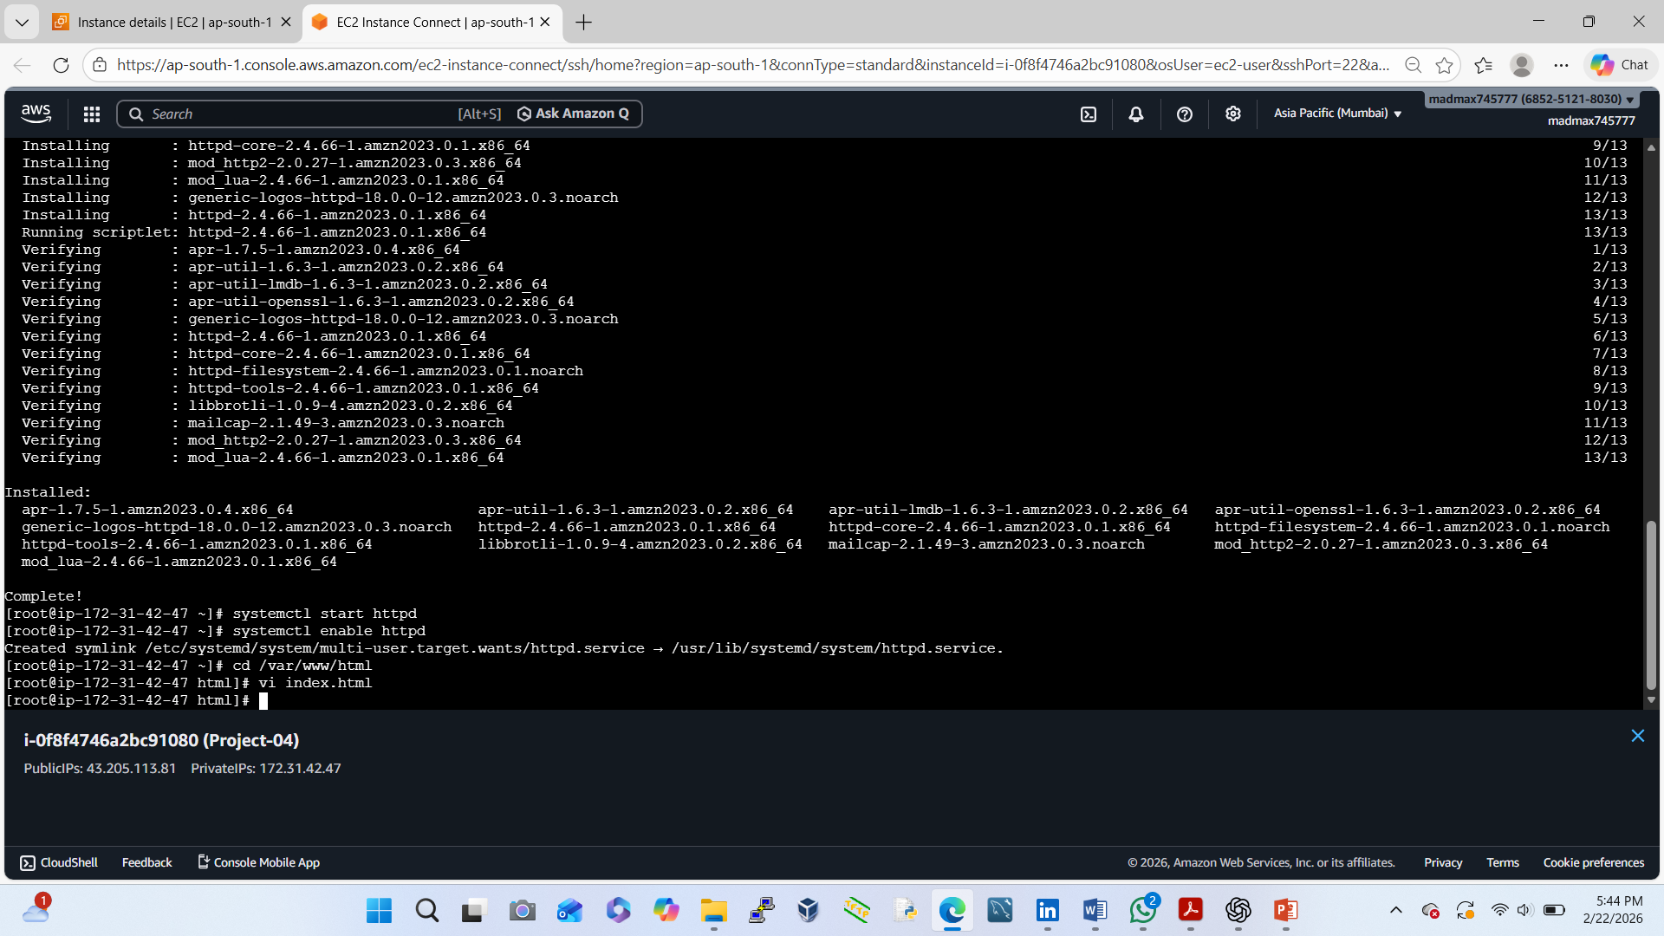
Launch EC2 & Configure Web Server
Login to Amazon Web Services Console
Go to EC2 → Launch Instance
Choose:
AMI: Amazon Linux 2
✔Instance type: t2.micro (Free Tier)
Configure:
✔Key pair: select/create
✔Security Group:
✔ SSH → Port 22 (My IP)
✔HTTP → Port 80 (Anywhere)
Launch the instance
✔Install Web Server
✔Connect via SSH:

Slide 3
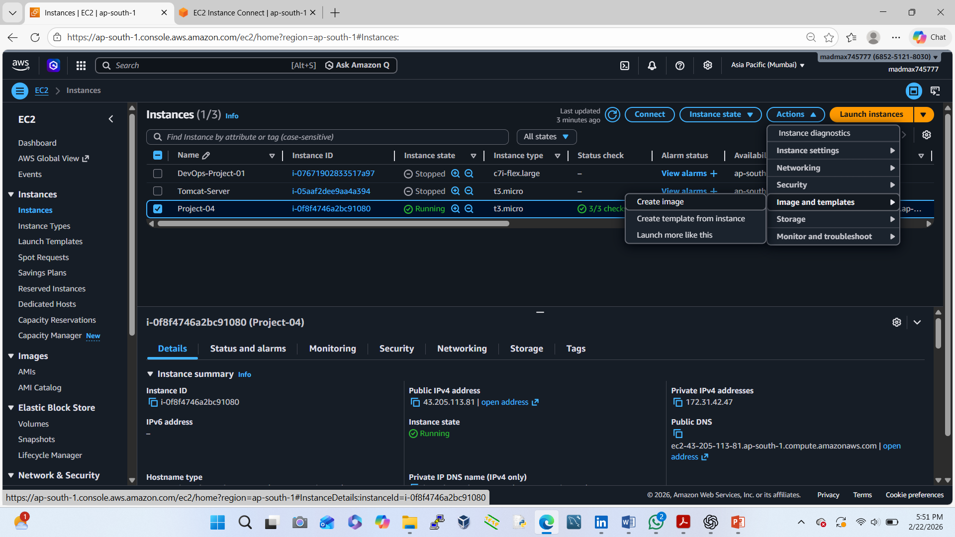
Create the Golden AMI
Go to EC2 → Instances
Select our configured EC2
Click Actions → Image and templates → Create Image
Enter:
✔Name: golden-ami-webserver
✔Description: Apache configured EC2
Click Create Image
✔Wait until AMI status becomes Available

Slide 4
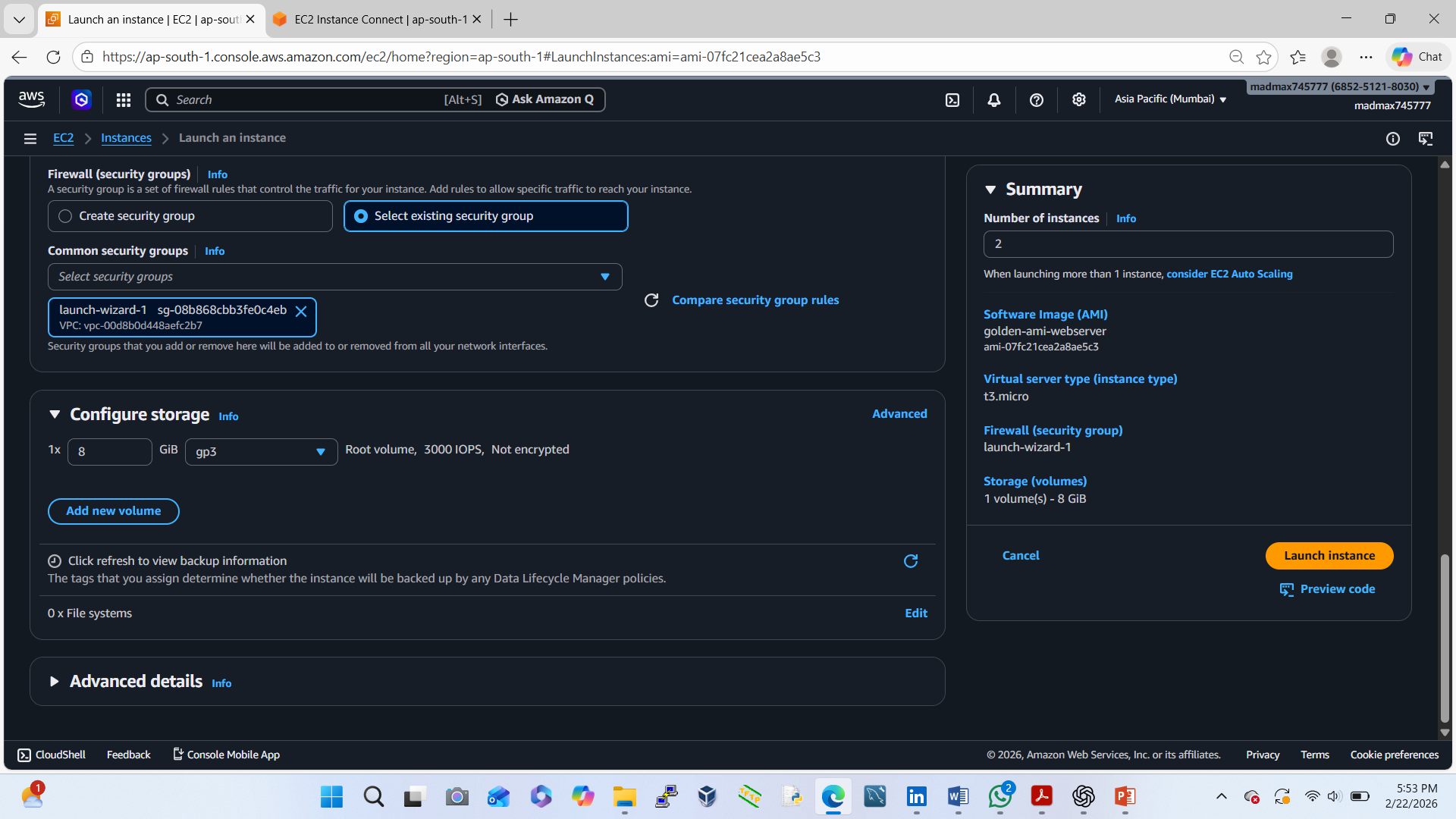
Launch Multiple EC2 from Golden AMI
Go to EC2 → AMIs
Select golden-ami-webserver
Click Launch Instance from AMI
Choose:
✔ Instance type: t2.micro
✔Same security group
Launch 2 or more instances

Slide 5
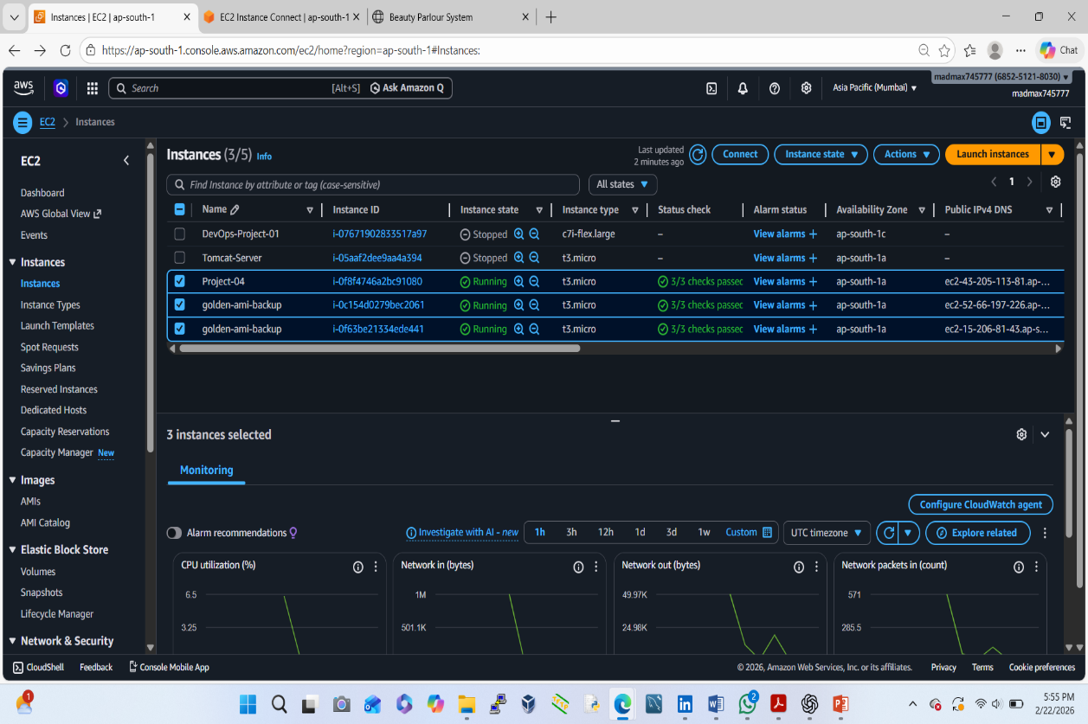
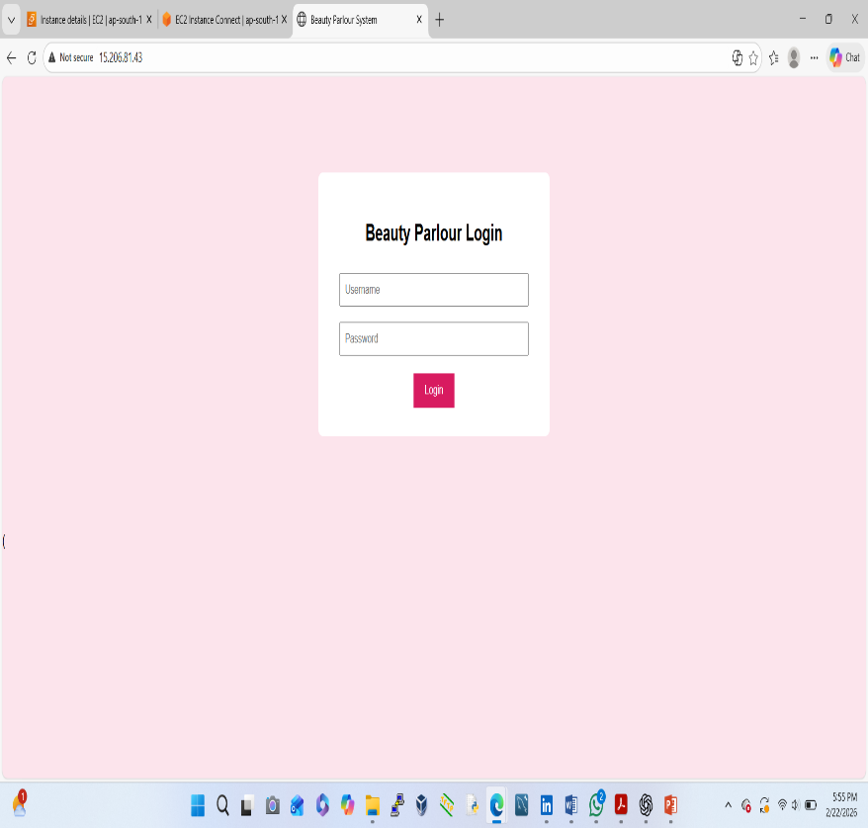
Verify Identical Configuration
For each new EC2
Copy Public IP
Open in browser
✔ Chrome
✔ Google

